Slide 1
On the added value of chemical reanalyses in the middle atmosphere: lessons learned from the BASCOE Reanalysis of Aura MLS, version 2 (BRAM2)
Q. Errera¹, S. Chabrillat¹, Y. Christophe¹, J. Debosscher¹, D. Hubert¹, D. Minganti¹, M. Santee², M. Shiotani³, S. Skachko⁴, T. von Clarman⁵ and K. Walker⁶
AGU Fall Meeting, 2019, San Francisco, USA
¹Royal Belgian Institute for Space Aeronomy; ²Jet Propulsion Laboratory, USA; ³Kyoto University, Japan;
⁴Environment and Climate Change Canada; ⁵Karlsruhe Institute of Technology, Germany; ⁶University of Toronto, Canada

Slide 2
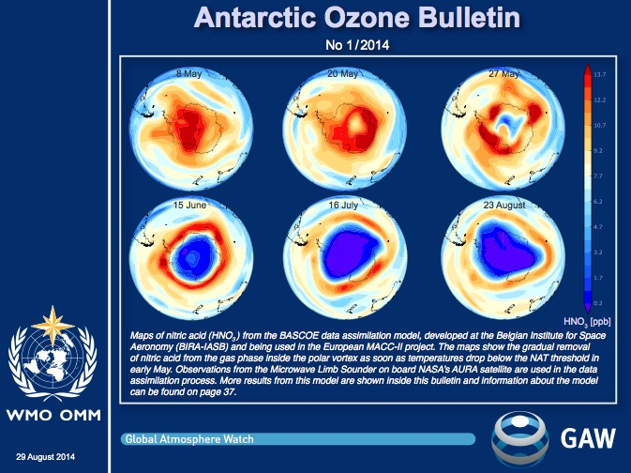
Motivations
BASCOE produces operational analyses of Aura MLS profiles since 2009 for the validation of CAMS O₃ (Lefever et al., ACP, 2015; www.copernicus-stratosphere.eu)
For this service, BASCOE assimilates O₃, H₂O, HNO₃, N₂O, HCl and ClO
These analyses are used by WMO Global Atmospheric Watch (GAW) Antarctic Ozone Bulletins to interpret ground-based observations
A reanalysis of MLS was requested by WMO GAW
BRAM: BASCOE Reanalysis of Aura MLS
Right: cover page of WMO Antarctic Ozone Bulletin 1/2014 showing the removal of HNO3 by PSC sedimentation from BASCOE analyses.

Slide 3
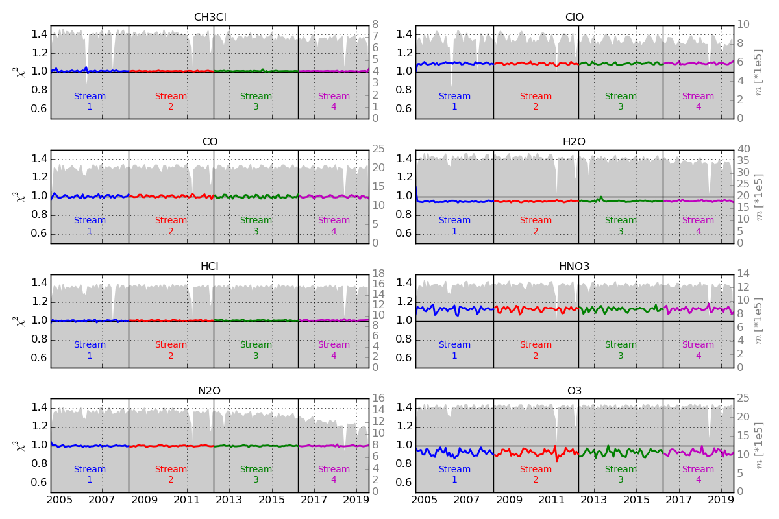
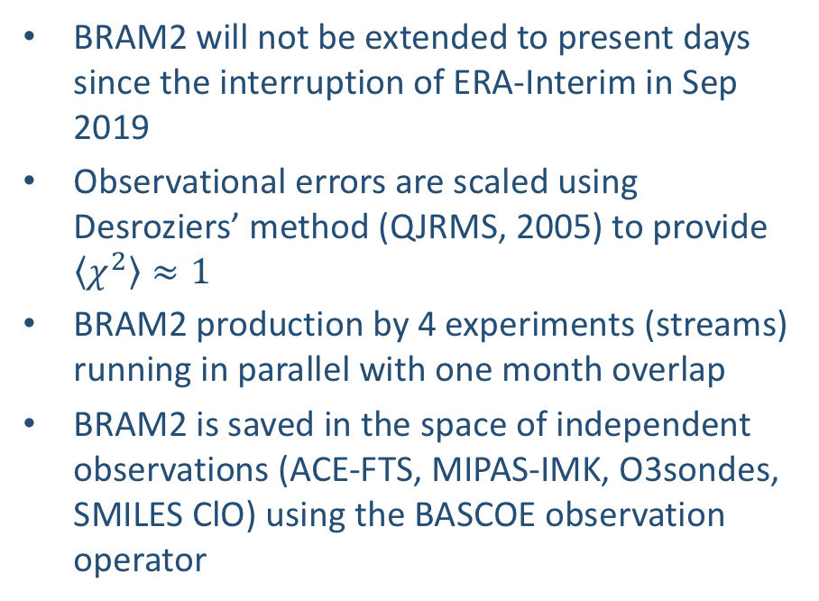
BRAM2 (BASCOE Reanalysis of Aura MLS, version 2)
A 15-year reanalysis (Sep 2004-Aug 2019) based on the assimilation of MLS v4 profiles using the Belgian Assimilation System for Chemical ObsErvations (BASCOE, Errera et al., ACP, 2019)
Profiles of 8 species assimilated: O₃, H₂O, HNO₃, N₂O, HCl, ClO, CO and CH₃Cl
BASCOE-EnKF (Skachko et al., GMD, 2014, 2016) where the CTM is driven by ERA-Interim at 3,75°lon x 2,5° lat x 37 levels from the surface to 0.1 hPa (25 levels above 100 hPa) and 30’ model time step
BRAM2 will not be extended to present days since the interruption of ERA-Interim in Sep 2019
Observational errors are scaled using Desroziers’ method (QJRMS, 2005) to provide $\left\langle χ^{2}\right\rangle ≈1$
BRAM2 production by 4 experiments (streams) running in parallel with one month overlap
BRAM2 is saved in the space of independent observations (ACE-FTS, MIPAS-IMK, O3sondes, SMILES ClO) using the BASCOE observation operator

Slide 4
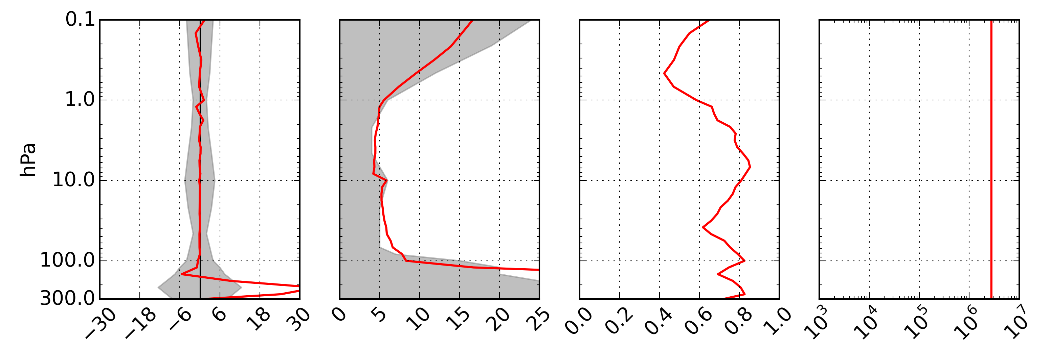
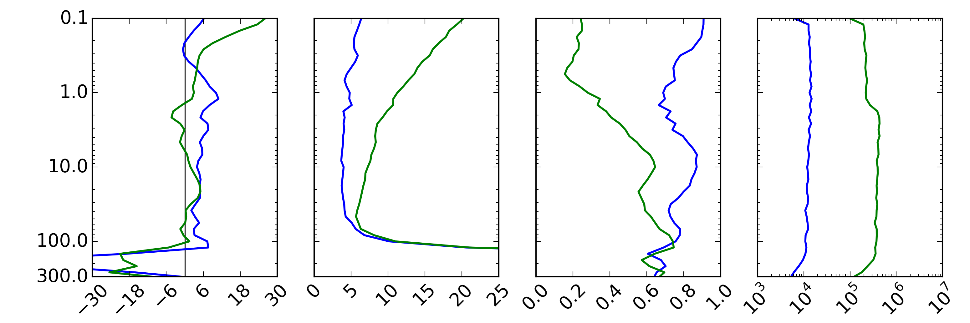
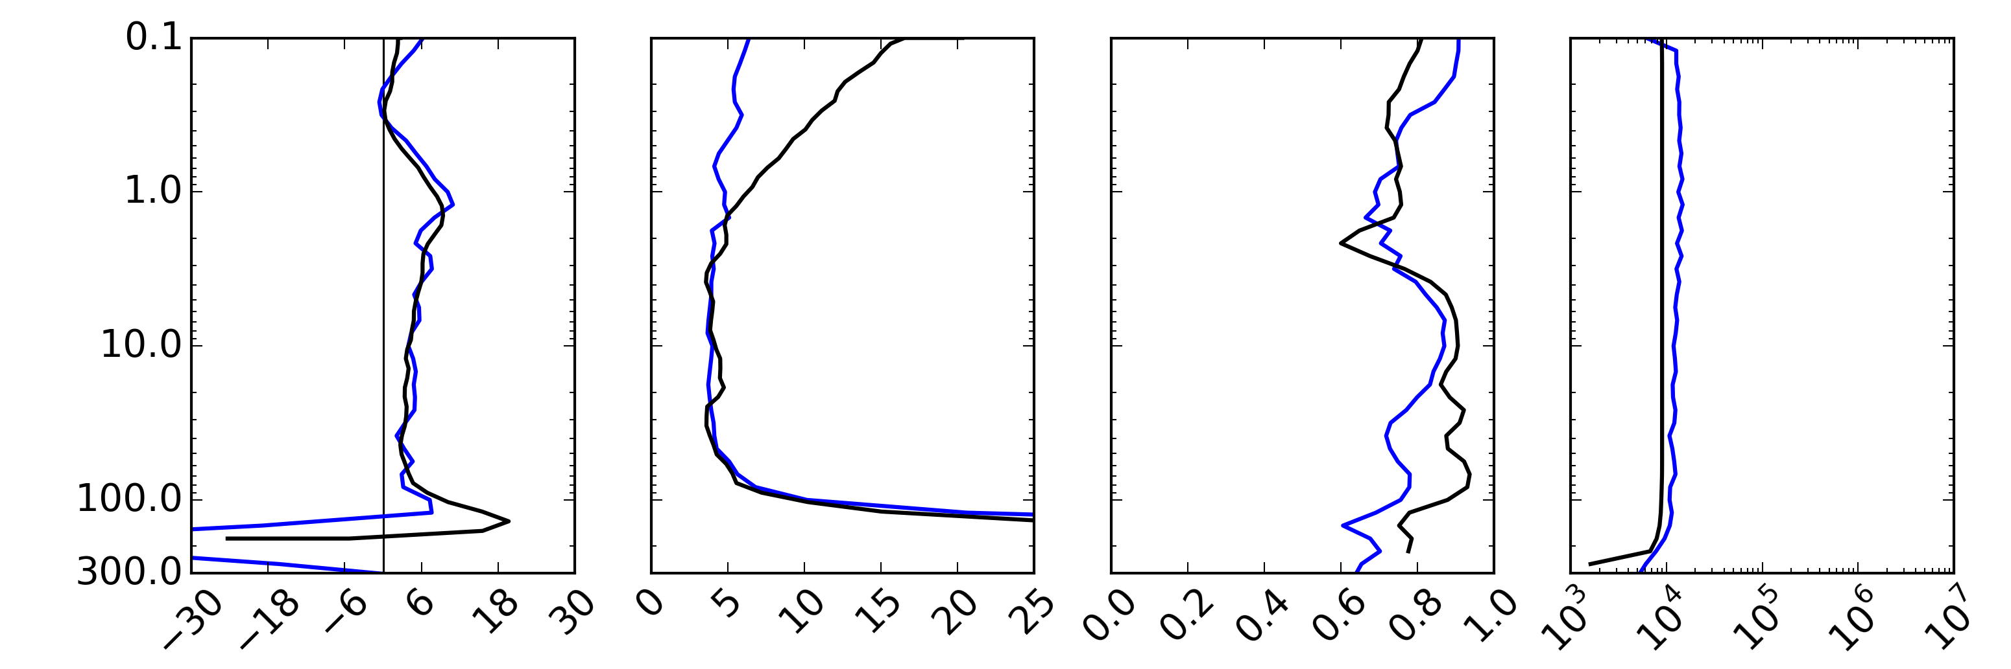
Added value to MLS: middle stratospheric H₂O
BRAM2 H₂O reproduces MLS within MLS uncertainty from the tropopause to 0.1 hPa
In good agreement with independent observations (MIPAS and ACE-FTS)
Confirm previous validation studies based on intercomparison of co-located profiles but without the need for a colocation criteria => larger sample
BRAM2 (H₂O) is a good proxy of MLS but in 4 dimensions
Mean(BRAM2-Obs)
STD(BRAM2-Obs)
CORR(BRAM2,Obs)
Nobs
BRAM2 H2O vs obs. in 30-60°N:
MLS (2005-2018)
ACE-FTS (2005-2018)
MIPAS (2005-2012)
MLS accuracy (left) and precision (centre)
MLS-ACEFTS from Sheese et al., JQRST, 2017

Slide 5
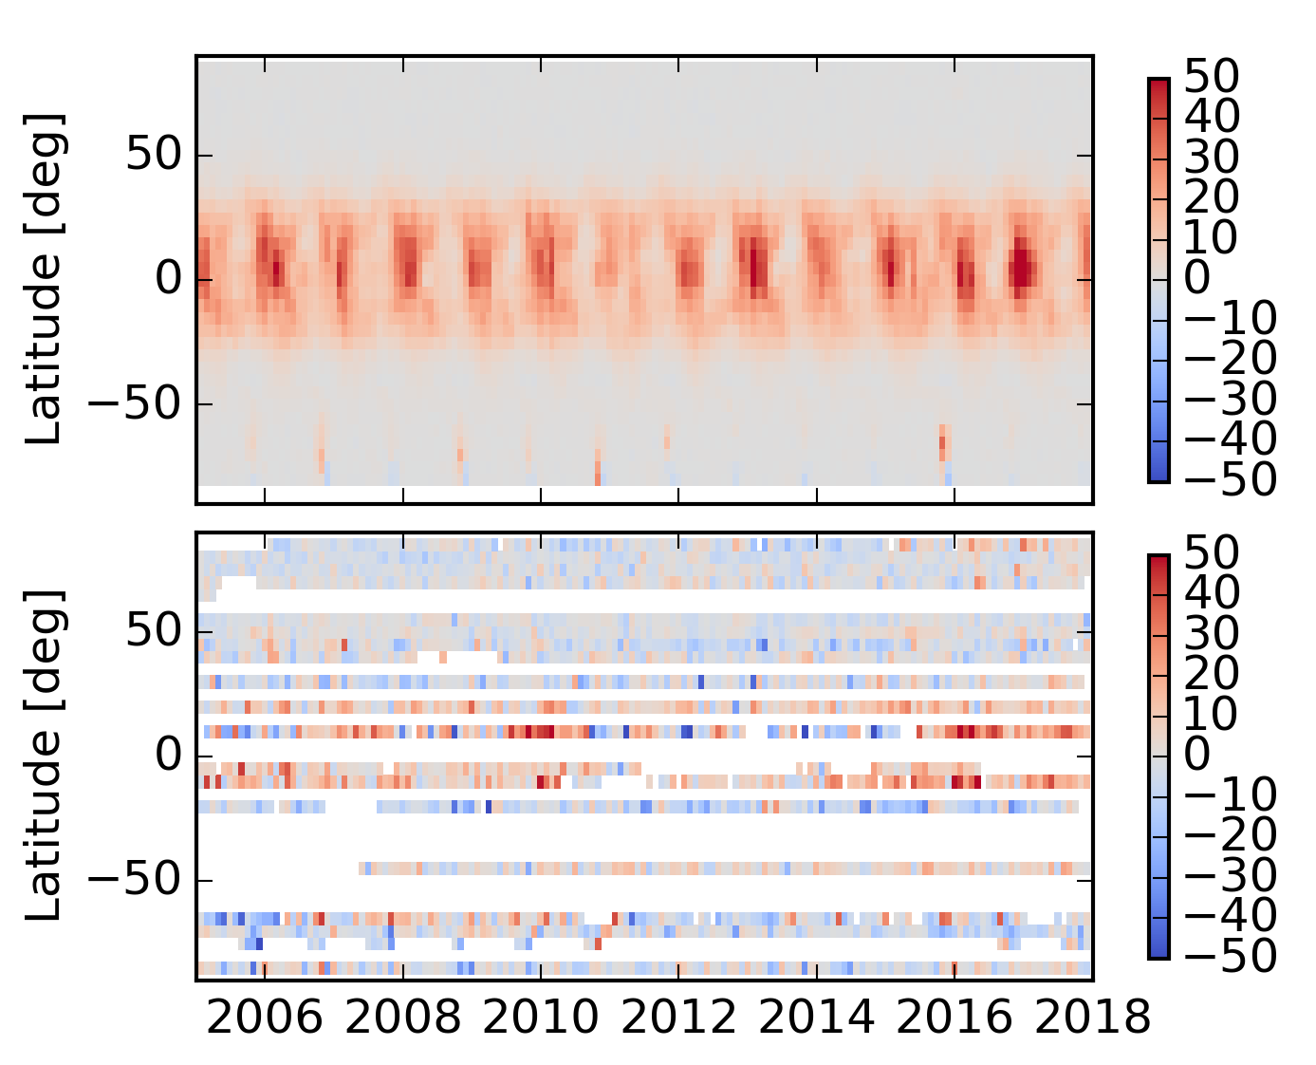
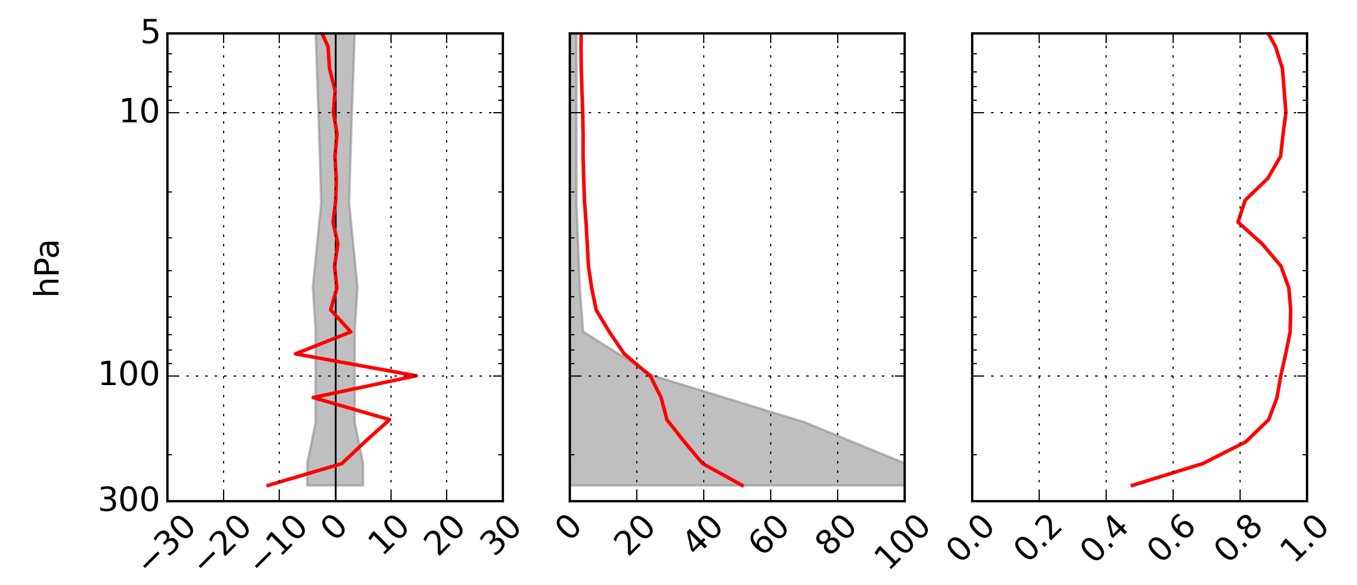
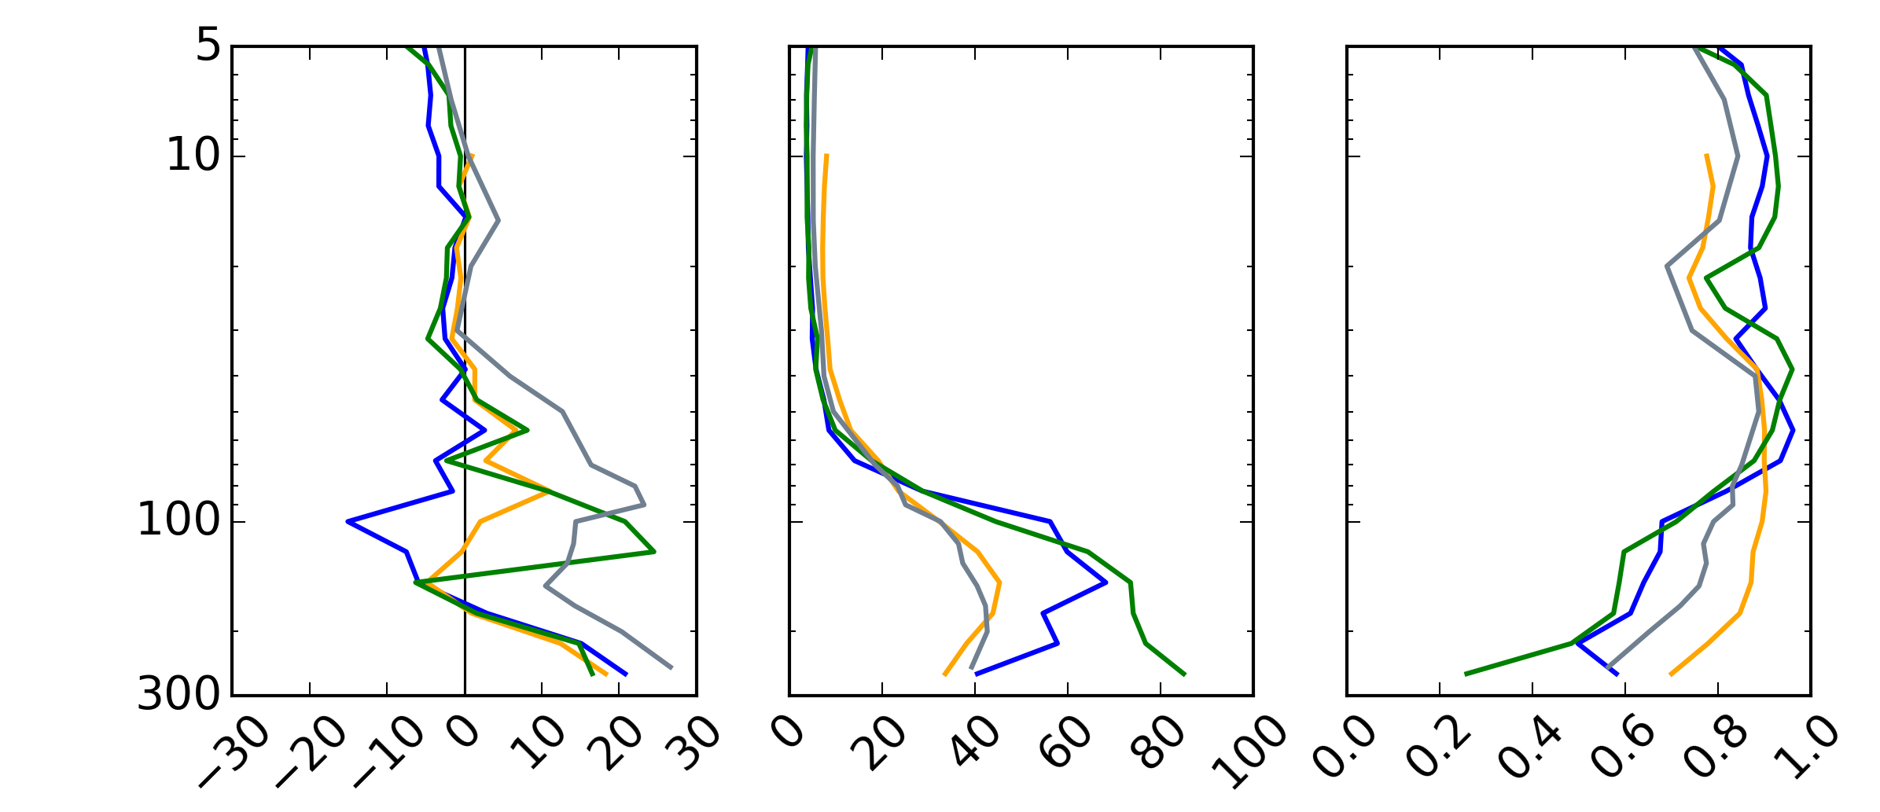
Added value to MLS: O₃ in the tropical tropopause layer (TTL)
Vertical oscillation in MLS O₃ profiles in the TTL (known issue)
BRAM2 cannot match MLS and find a compromise, in good agreement with independent observations
BRAM2 could be used as a transfer function to remove the bias of MLS using O3Sondes as anchor
Time series of monthly zonal mean bias (BRAM2-Obs) at 100 hPa against MLS (top) and O3Sondes (bottom) binned on a 5° lat bins
BRAM2-Observation statistics between 30°S-30°N
Mean(BRAM2-Obs)
STD(BRAM2-Obs)
CORR(BRAM2,Obs)
BRAM2-MLS
BRAM2-ACEFTS
BRAM2-MIPAS
BRAM2-CCI_OSIRIS
BRAM2-O3Sondes
MLS accuracy (left) and precision (centre)
%
%

Slide 6
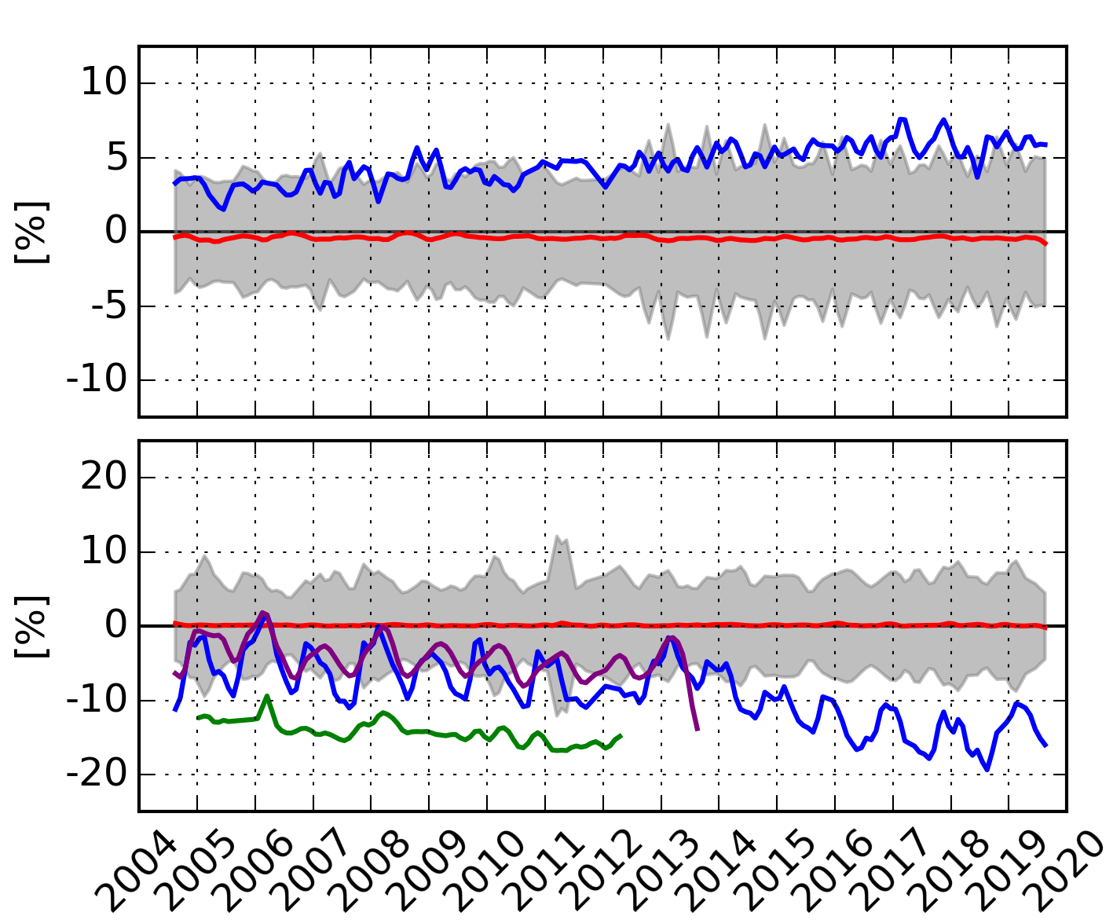
Drift between observational datasets
Monthly differences (BRAM2-Obs) (in %) between 30°N-60°N
Comparison against independent observations highlights (known) drifts in MLS observations for HCl and N₂O (MLS and BRAM2 are unbiased)
Using BRAM2 as a transfer function between MLS and the independent observations would allow one to:
  Estimates bias and drifts between observational datasets
  Find the origin of biases (p, T, sza) and develop model of bias correction scheme
  Without relying on any colocation criteria hence using the complete set of independent observations
HCl @ 4.6 hPa
N₂O @ 46 hPa
Mean(BRAM2-MLS) Mean(BRAM2-ACEFTS)
Mean(BRAM2-MIPAS) Mean(BRAM2-MLS_640_N20)
STD(BRAM2-ACEFTS)

Slide 7
Applications: Evaluation of BDC in a CCM and four meteorological reanalyses
Evaluation of the Brewer-Dobson circulation (BDC) in WACCM-4 using as diagnostic
the Transformed Eulerian Mean (TEM) tracer budget analysis for N₂O :
TEM analyses are done using daily fields of winds and N₂O over 2005-2015 by:
  WACCM-4 REF-C1 simulations for CCMi (3 runs): free dyn, free chem
  Four BASCOE-CTM runs driven by MERRA, MERRA-2, JRA55 and ERA-Interim: constrained dyn, free chem; contributes to S-RIP
  BRAM2: constrained dyn (from ERA-I) and constrained chem (from MLS)
More details in Minganti et al. (in prep for ACPD) and AGU Poster AS33S-3090
Meridonal residual advection
Horizontal transport by eddy mixing (M_{y})
Vertical residual
advection (v_{a})
Vertical eddy mixing
Chemical production and loss
residual of the TEM budget

Slide 8
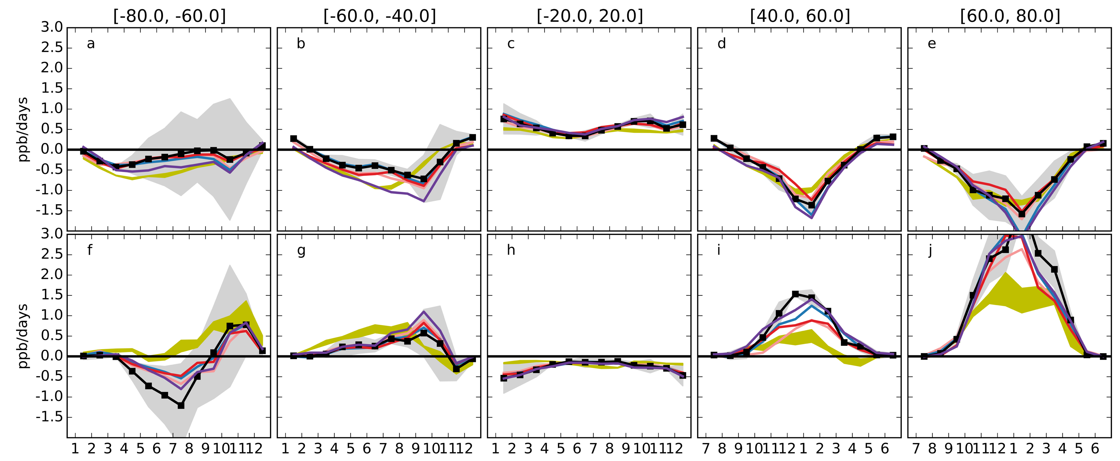
Applications: Evaluation of BDC in a CCM and four meteorological reanalyses
v_{a}
v_{a} (top) and M_{y} (bottom) monthly climatology at 15 hPa in five latitude bands:
-80°:-60°,
-60°:-40°,
-20°:20°,
40°:60°,
60°:80°.
M_{y}
Jan
Apr
Jul
Oct
Jan
Apr
Jul
Oct
Jan
Apr
Jul
Oct
Jul
Oct
Jan
Apr
Jul
Oct
Jan
Apr
CTM+
CTM+
CTM+
CTM+

Slide 9
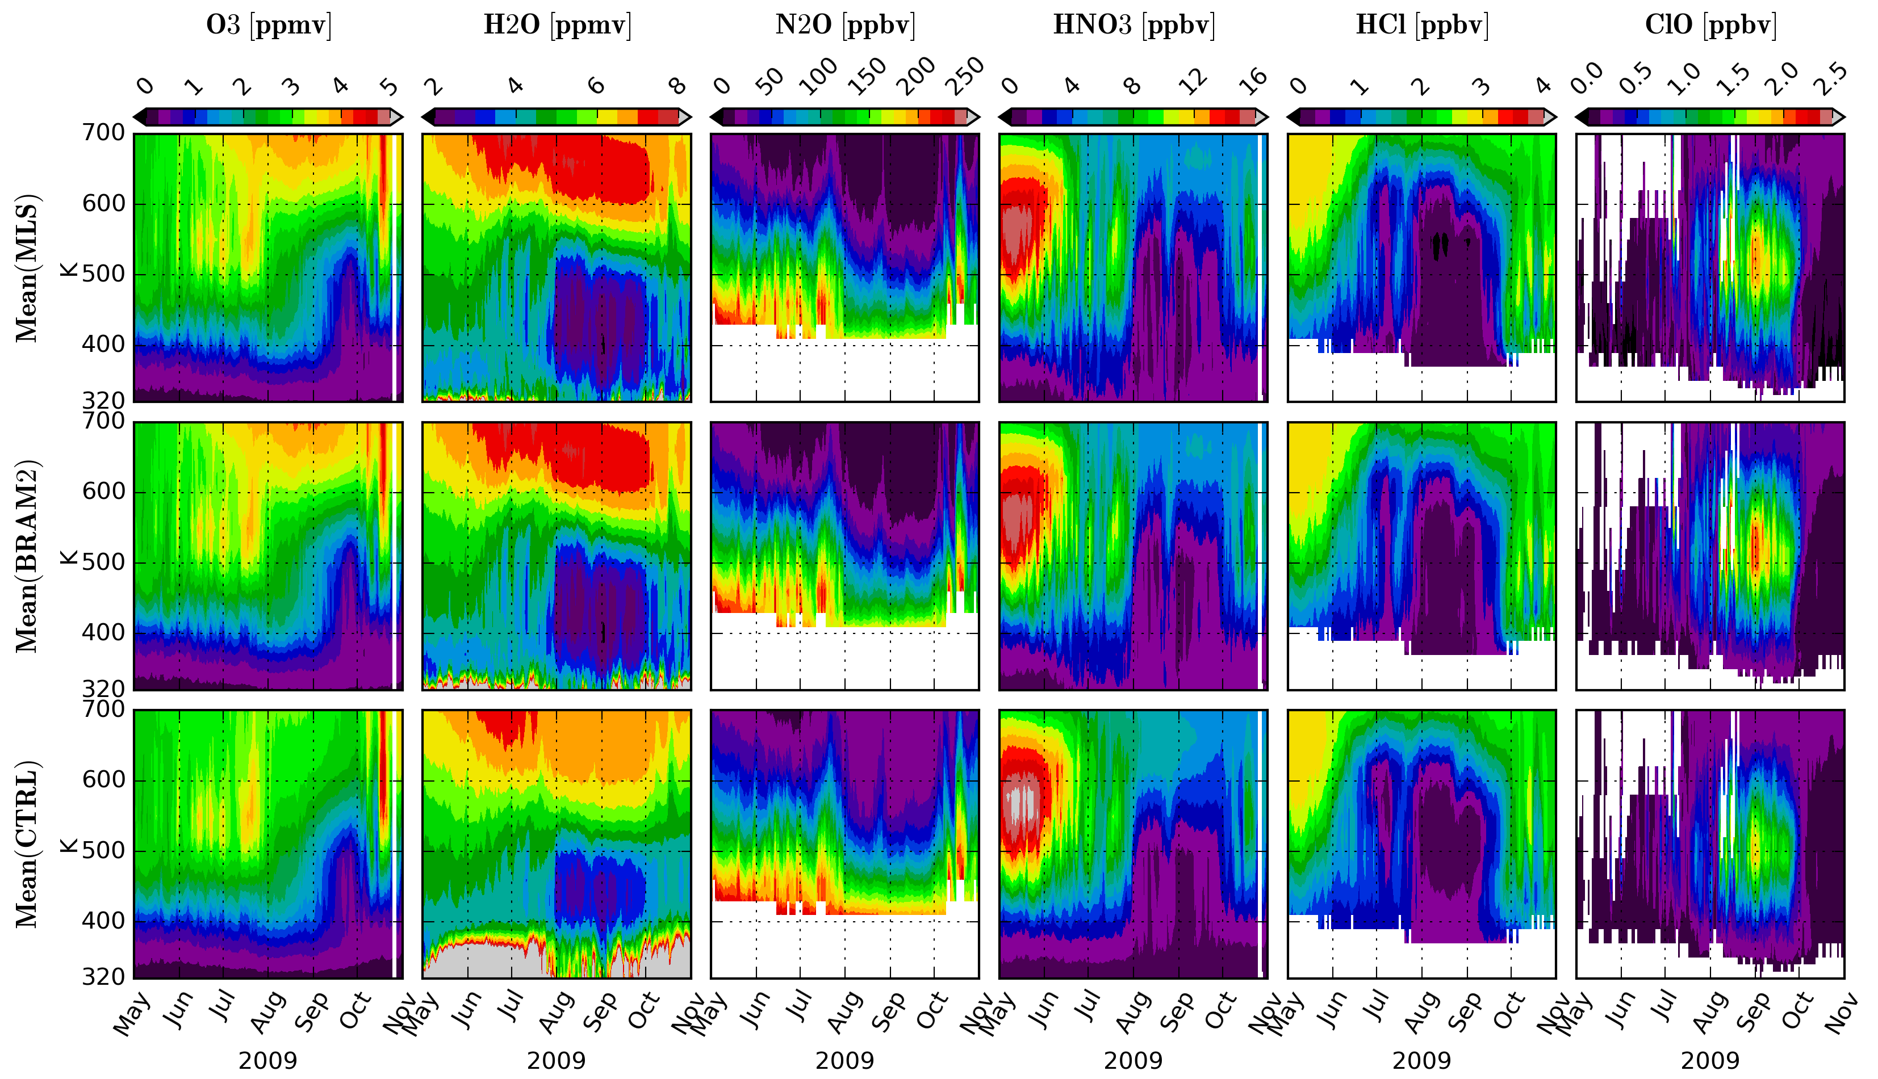
Added value to the BASCOE CTM: chemical evolution of the lower stratospheric polar vortex leading to the ozone hole
Left: Time series of daily mean MLS profiles (top), their BRAM2 counterpart (centre) and BASCOE free CTM run (bottom) in the inner vortex (<75°S) during the Antarctic winter 2009 for O₃, H₂O, N₂O, HNO₃, HCl and ClO.

Slide 10
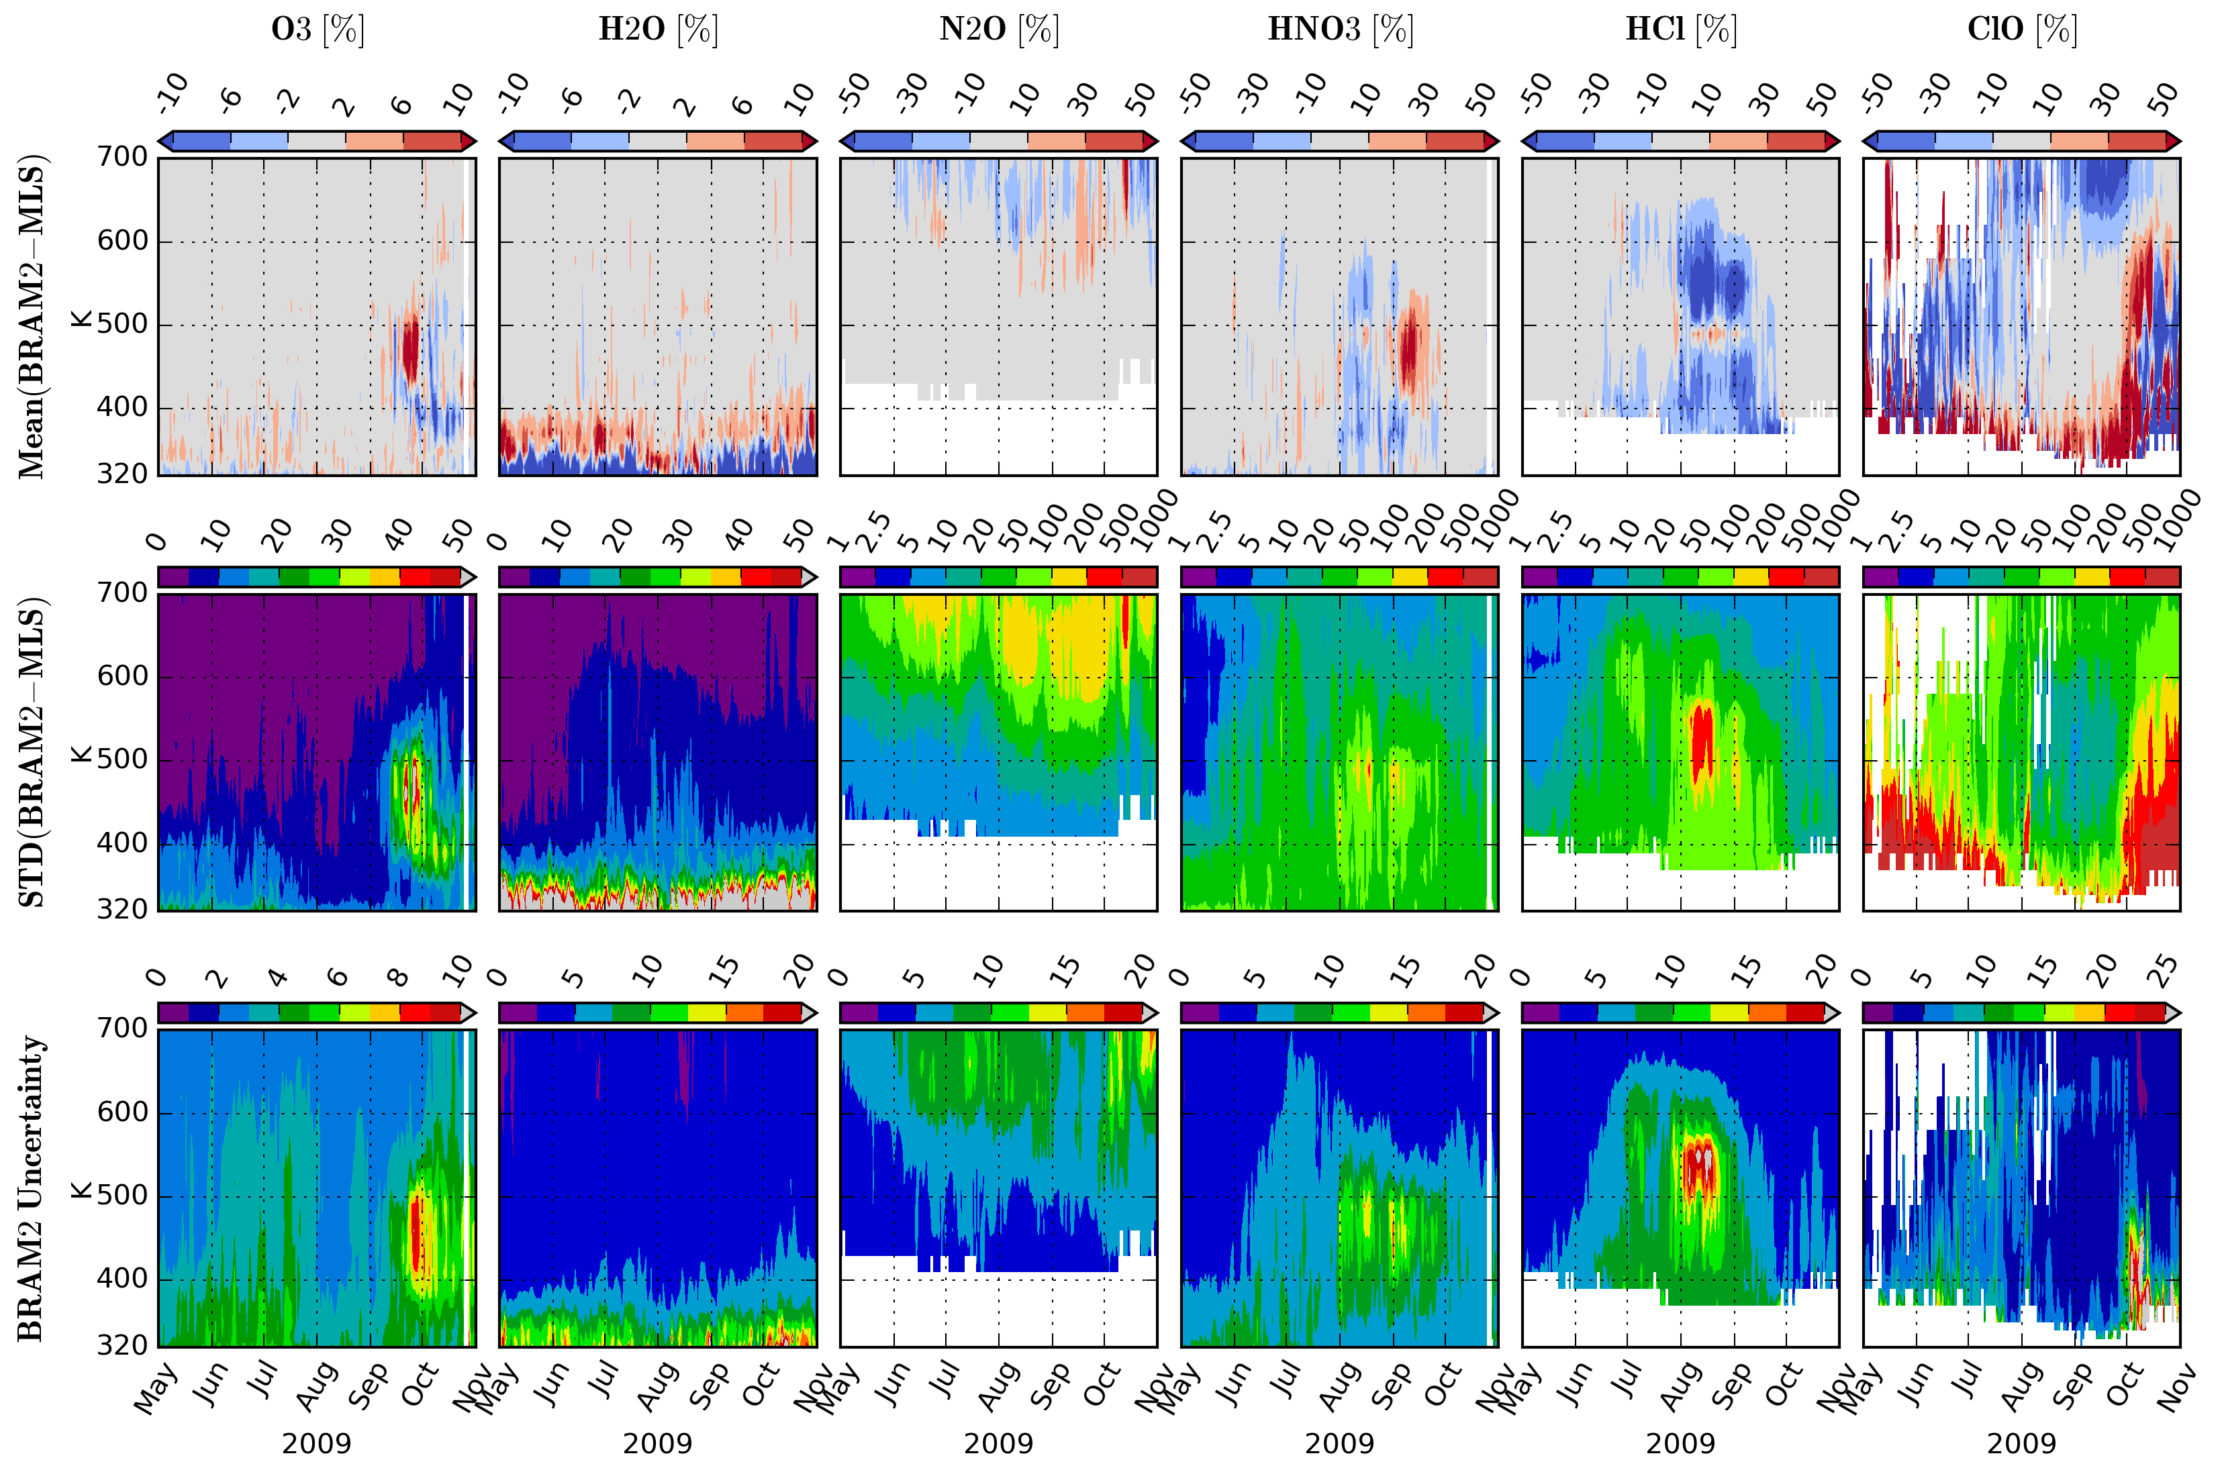
BRAM2 uncertainty based on the ensemble spread
Left: Time series of daily mean (BRAM2-MLS) (top), STD(BRAM2-MLS) (centre) and the BRAM2 uncertainty (bottom) in the inner vortex (<75°S) during the Antarctic winter 2009 for O₃, H₂O, N₂O, HNO₃, HCl and ClO.

Slide 11
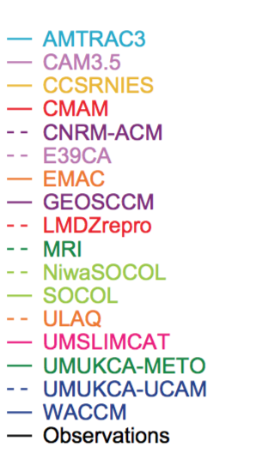
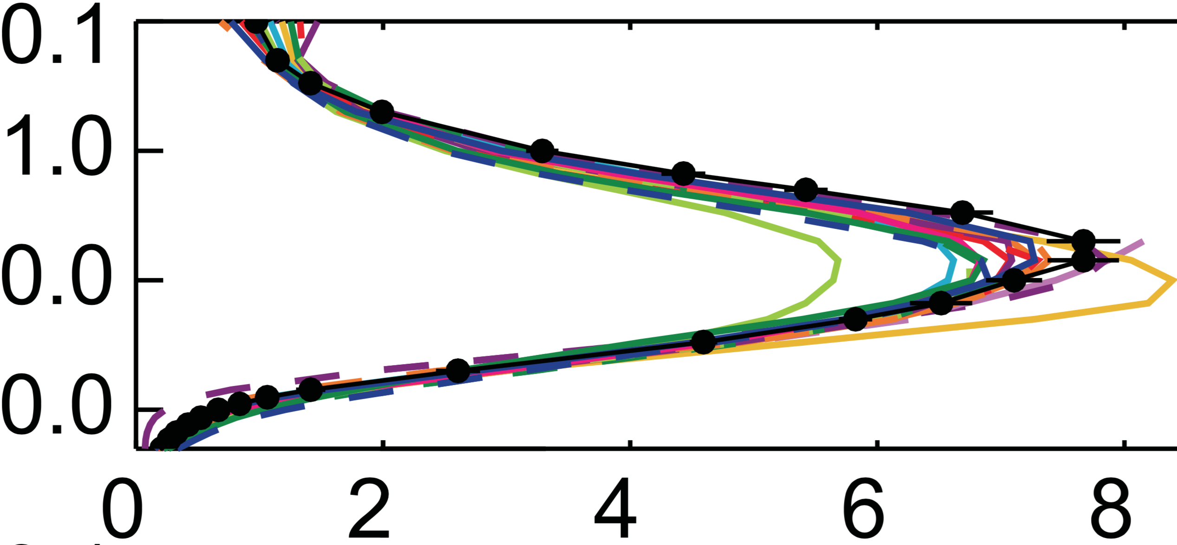
BRAM2 issue: BASCOE-CTM ozone deficit
Like many other models (see SPARC/CCMVal), BASCOE-CTM has an ozone deficit arount 1 hPa (20% bias vs MLS)
Due to the small chemical time scale of ozone at these altitudes, DA cannot correct for this bias
BRAM2 ozone is only valid between 4-250 hPa
0.1
Comparison between MIPAS ozone and CCMVal models (from SPARC/CCMVal report, Fig. 6.17)
1
Pressure (hPa)
10
100
O3 (ppmv)

Slide 12
Conclusions
BRAM2 adds values to MLS (O₃ vertical oscillations, extrapolation in 4D) and the BASCOE CTM (e.g. in the upper stratosphere polar vortex)
BRAM2 can be used to diagnose differences between instruments (bias, drifts)
As 4D datasets, BRAM2 can be used – for example – to diagnose transport in the stratosphere (TEM analyses)
BRAM2 6-hourly analysis (NetCDF-CF) available after registration: see http://strato.aeronomie.be > Datasets > BRAM2
BRAM2 state in the space of independent observations available upon request
This presentation is available here: http:// strato.aeronomie.be > Presentations

